Slide 1
Evolved ecosystems: A simulation of an emerging complex adaptive system
Presentation of Master’s thesis work by Joakim Johansson

Slide 2
Presentation outline
Introduction
Model
Results
Discussion
Conclusion

Slide 3
Introduction
Background, purpose and limitations

Slide 4
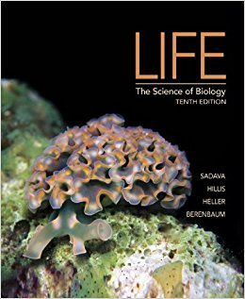
What is life?
“Life is the condition that separate living things from dead things”
Life
Usually consist of cells
Cells convert molecules from environment to biomolecules
Cells use energy from environment
Contain genetic information
Reproduce while replicating genetic information
Populations evolve over time
Self-regulate their internal environments to maintain living conditions
Made up of certain chemical components
Notes:
Simplified list, some forms of life does not display characteristics all the time
Seed of a desert plant
Viruses have no cells, but depend on cells

Slide 5
Artificial life
Life is more than organic (Langton 1986)
Wet alife
Software-based
Hard alife
Soft alife
Biochemical-based
Synthetic biology
Hardware-based
Robots
Computer-simulated life

Slide 6
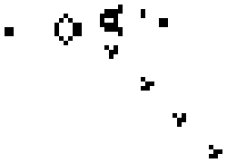
Conway's Game of Life – 1970
Polyworld – 1990
Species - 2011
Tierra - 1992
https://commons.wikimedia.org/wiki/File:Gospers_glider_gun.gif
https://en.wikipedia.org/wiki/File:Polyworld.gif
Tierra, © Marc Cygnus
https://speciesdevblog.files.wordpress.com/2015/09/test1.jpg

Slide 7
Model

Slide 8
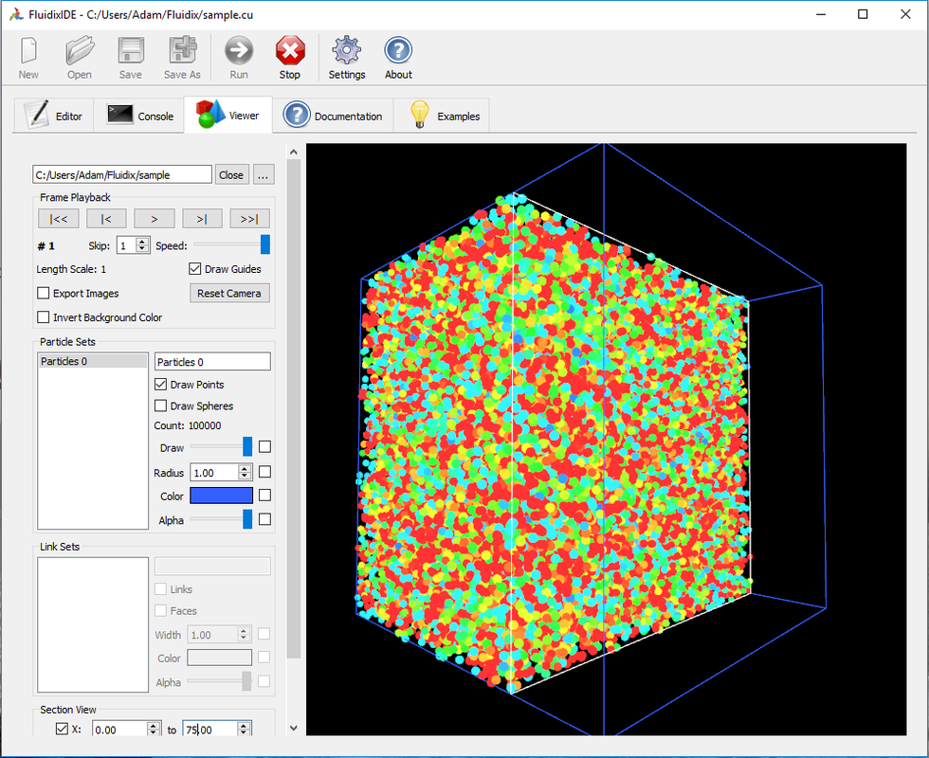
Fluidix library
CUDA-based particle simulation
Used for controlling local particle interactions
http://www.fluidix.ca/

Slide 9
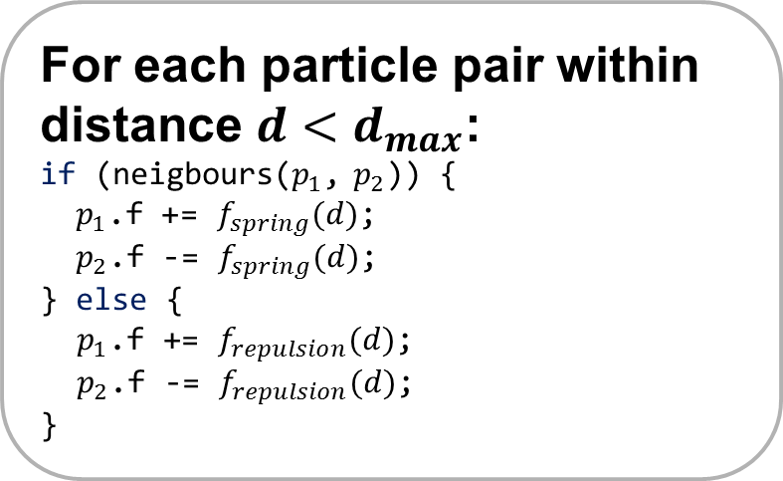
Particle-based simulation physics
For each particle:
//integrate:
p.v += p.f * dt;
p.r += p.v * dt;
p.f = 0;
p.v *= 0.97f; //friction
Particle p
Position r
Velocity v
Force f
...
For each particle pair within distance $d<d_{max}$:
if (neigbours($p_{1}$, $p_{2}$)) {
$p_{1}$.f += $f_{spring}(d)$;
$p_{2}$.f -= $f_{spring}(d)$;
} else {
$p_{1}$.f += $f_{repulsion}(d)$;
$p_{2}$.f -= $f_{repulsion}(d)$;
}

Slide 10
Particle types
Cell
Pellet
Building blocks of organisms
Buffer
Energy
Dead cells
Checks for visible sky for photosynthesis
Keeps # of particles constant

Slide 11
Cell types
Photo
Digest
Sting
Vascular
Create energy from light
Consume dead cells
Steal energy from foreign cells
Transport energy within organism
Fat
Store energy
Sense
Sensor input to nervous system
Egg
Store energy and form new organism at threshold

Slide 12
The arena
Earth, air and water

Slide 13
Definition of an organism
Nervous system
List of cells
Genome
Organism
Nodes
Connections
Bounding radius
Nodes
Connections

Slide 14
Evolving patterns using networks
Compositional Pattern Producing Networks
Stanley (2007)
Neuroevolution of Augmenting Topologies
Stanley (2002)

Slide 15
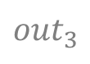
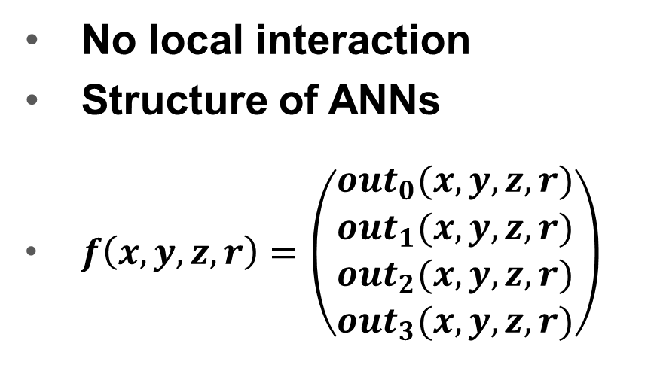
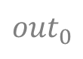
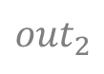
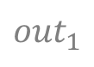
Input
x
y
z
r
CPPN
Compositional Pattern Producing Networks
No local interaction
Structure of ANNs
$f\left(x,y,z,r\right)=\left(\begin{matrix}{out}_{0}(x,y,z,r) \\ {out}_{1}(x,y,z,r) \\ \begin{aligned}{out}_{2}(x,y,z,r) \\ {out}_{3}(x,y,z,r)\end{aligned}\end{matrix}\right)$
Output
$${out}_{0}$$
$${out}_{1}$$
$${out}_{2}$$
$${out}_{3}$$

Slide 17
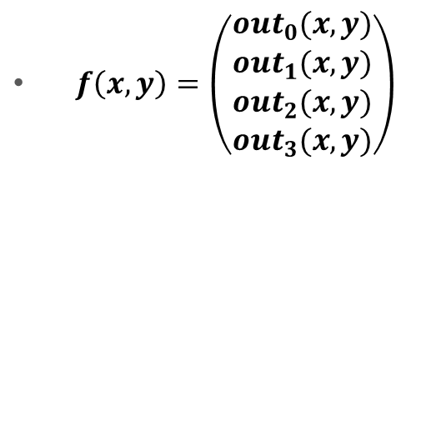
CPPN
-2
-2
Encoding patterns - Example
 | -2 | -1 | 0 | 1 | 2
-2
-1
0
1
2
-1
 | -2 | -1 | 0 | 1 | 2
-2
-1
0
1
2
-1
-1
-1
$f\left(x,y\right)=\left(\begin{matrix}{out}_{0}(x,y) \\ {out}_{1}(x,y) \\ \begin{aligned}{out}_{2}(x,y) \\ {out}_{3}(x,y)\end{aligned}\end{matrix}\right)$
0
0
-1
0
0
-1
0
1
-1

Slide 18
CPPN
-2
-1
Encoding patterns - Example
 | -2 | -1 | 0 | 1 | 2
-2
-1
0
1
2
-1
 | -2 | -1 | 0 | 1 | 2
-2
-1
0
1
2
-1
-1
-1
$f\left(x,y\right)=\left(\begin{matrix}{out}_{0}(x,y) \\ {out}_{1}(x,y) \\ \begin{aligned}{out}_{2}(x,y) \\ {out}_{3}(x,y)\end{aligned}\end{matrix}\right)$
0
0
-1
0
0
-1
0
1
-1

Slide 19
CPPN
-2
0
Encoding patterns - Example
 | -2 | -1 | 0 | 1 | 2
-2
-1
0
1
2
0
 | -2 | -1 | 0 | 1 | 2
-2
-1
0
1
2
-1
0
0
$f\left(x,y\right)=\left(\begin{matrix}{out}_{0}(x,y) \\ {out}_{1}(x,y) \\ \begin{aligned}{out}_{2}(x,y) \\ {out}_{3}(x,y)\end{aligned}\end{matrix}\right)$
1
1
-1
1
1
0
1
0
0

Slide 20
CPPN
x
y
Encoding patterns - Example
 | -2 | -1 | 0 | 1 | 2
-2
-1
0
1
2
$f\left(x,y\right)=\left(\begin{matrix}{out}_{0}(x,y) \\ {out}_{1}(x,y) \\ \begin{aligned}{out}_{2}(x,y) \\ {out}_{3}(x,y)\end{aligned}\end{matrix}\right)$

Slide 21
Neuroevolution of Augmenting Topologies
Mutation toolbox:
Mutate connection weights
Add connection
Add node
# of inputs = 2
# of outputs = 3
Example: Start with fully connected network

Slide 22
Sense
1
Sense
2
Bias
Nervous system
Another network for each organism
Same structure as CPPN
Input from sensor cells and a bias node
Output to movement force vector
f.x
f.y
f.z

Slide 23
Results

Slide 24
